Slide 1
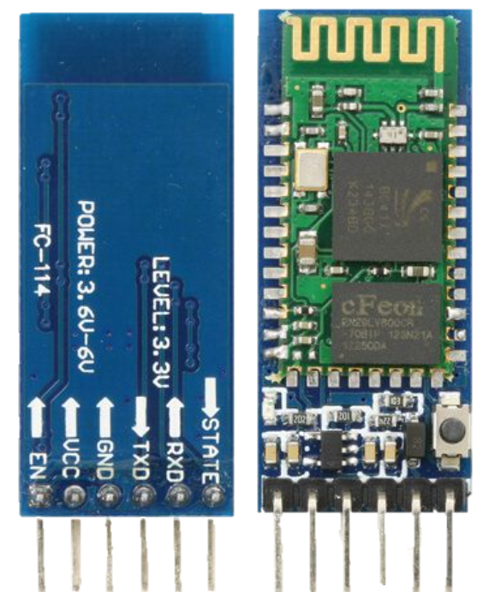
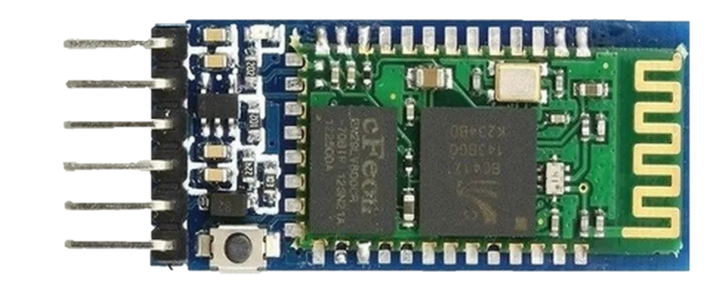
CONFIGURATION
55%
D
BLUETOOTH MODULE
35%
65%
65%
55%
C
B
CONFIGURATION
TYPE YOUR TEXT
TYPE YOUR TEXT
TYPE YOUR TEXT
A
FUNCTION OF THE PINS
PRINCIPLE OF OPERATION
35%
HOW TO USE
85%
1. Frequency: 2.4 GHz ISM band
25%
35%
2. Operating voltage: 3.3V to 5V
WRITE SOME TEXT HERE
APPLICATION
3. IC: BC417
TYPE YOUR TEXT
TYPE YOUR TEXT
A
B
C
TYPE YOUR TEXT
4. Flash memory: 8Mbit
5. Bluetooth version: 2.0 + EDR (Enhanced Data Rate)
6. Bluetooth system: Bluetooth CSR Bluecore 04 external single chip with CMOS technology

Slide 2
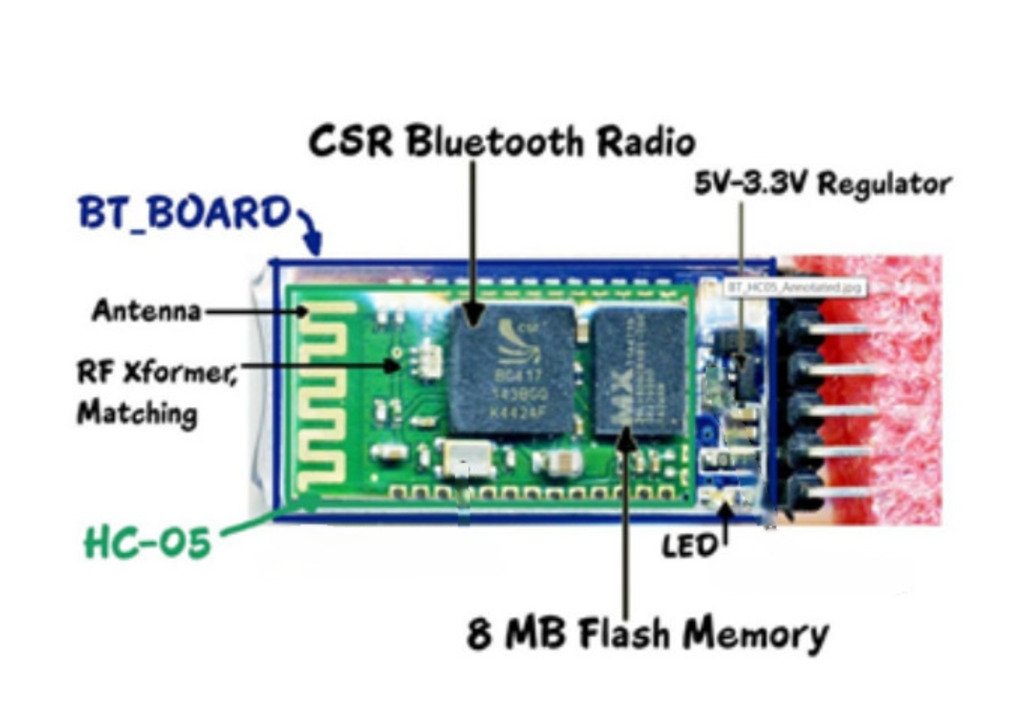
CONFIGURATION
55%
D
35%
65%
65%
55%
C
B
TYPE YOUR TEXT
TYPE YOUR TEXT
TYPE YOUR TEXT
A
85%
25%
35%
35%
1. Frequency: 2.4 GHz ISM band
7. Protocol: IEEE 802.15.1 standard
WRITE SOME TEXT HERE
2. Operating voltage: 3.3V to 5V
A
B
C
3. IC: BC417
TYPE YOUR TEXT
TYPE YOUR TEXT
TYPE YOUR TEXT
4. Flash memory: 8Mbit
5. Bluetooth version: 2.0 + EDR (Enhanced Data Rate)
6. Bluetooth system: Bluetooth CSR Bluecore 04 external single chip with CMOS technology

Slide 3
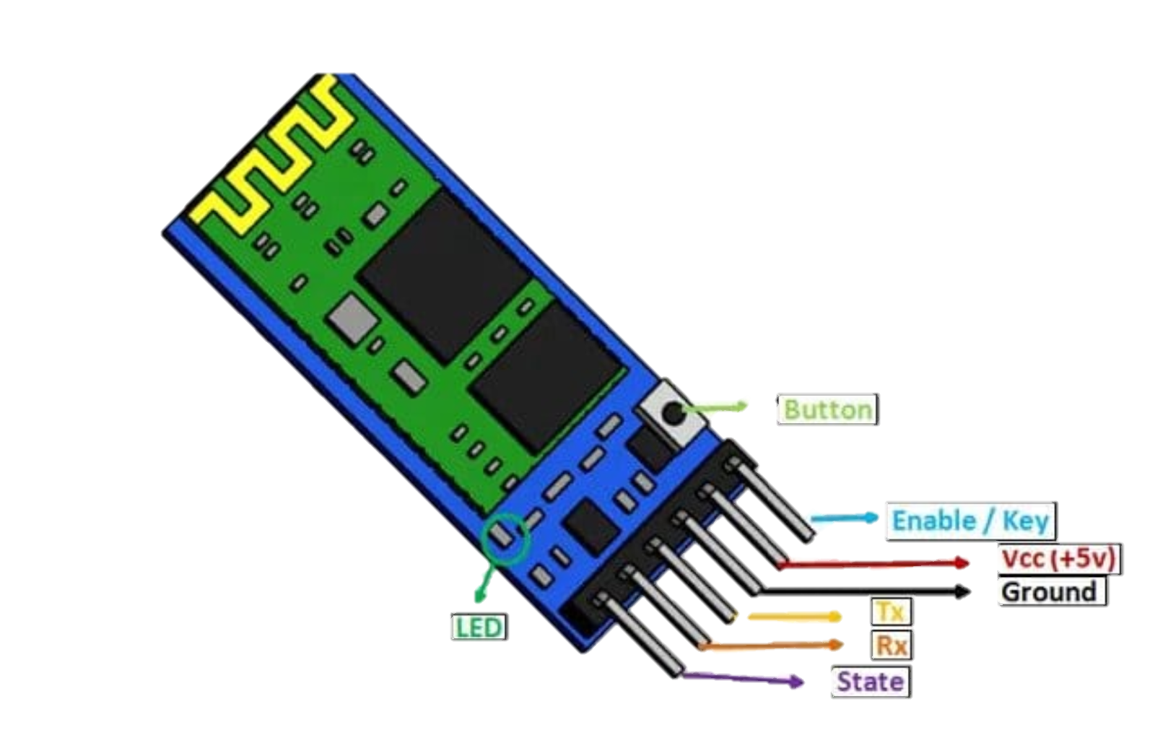
CONFIGURATION
FUNCTION OF THE PINS
1. VCC: Connect 5 V or 3.3 V to this Pin
D
2. GND: Ground Pin of module
65%
65%
55%
C
3. TXD: Transmit Serial data
4. RXD: Receive data serially
B
5. State: It tells whether module is connected or not.
TYPE YOUR TEXT
TYPE YOUR TEXT
TYPE YOUR TEXT
A
85%
25%
35%
1. Frequency: 2.4 GHz ISM band
7. Protocol: IEEE 802.15.1 standard
6. Enable/Key: The pin changes mode between data mode and command line mode by providing an external signal
2. Operating voltage: 3.3V to 5V
A
B
C
3. IC: BC417
TYPE YOUR TEXT
TYPE YOUR TEXT
TYPE YOUR TEXT
4. Flash memory: 8Mbit
7. Button: Change data and command modes
5. Bluetooth version: 2.0 + EDR (Enhanced Data Rate)
8. LED: shows the status of Module HC-05
6. Bluetooth system: Bluetooth CSR Bluecore 04 external single chip with CMOS technology

Slide 4
CONFIGURATION
PRINCIPLE OF OPERATIO
D
65%
65%
55%
C
B
TYPE YOUR TEXT
TYPE YOUR TEXT
TYPE YOUR TEXT
A
- Based on sequential communication protocol.
- Receive data and remove the beginning and end, then pass it through UART.
85%
25%
35%
1. Frequency: 2.4 GHz ISM band
7. Protocol: IEEE 802.15.1 standard
- Builds a Bluetooth packet and sends it over a Bluetooth wireless connection to the receiving device
2. Operating voltage: 3.3V to 5V
A
B
C
3. IC: BC417
TYPE YOUR TEXT
TYPE YOUR TEXT
TYPE YOUR TEXT
- HC-05 has two operating modes:
+ Command Mode:You can communicate with the Bluetooth module via AT commands
Ex: AT + NAME = ****** : To set/change device name
+ Data Mode: used to communicate with other Bluetooth devices
4. Flash memory: 8Mbit
5. Bluetooth version: 2.0 + EDR (Enhanced Data Rate)
6. Bluetooth system: Bluetooth CSR Bluecore 04 external single chip with CMOS technology

Slide 5
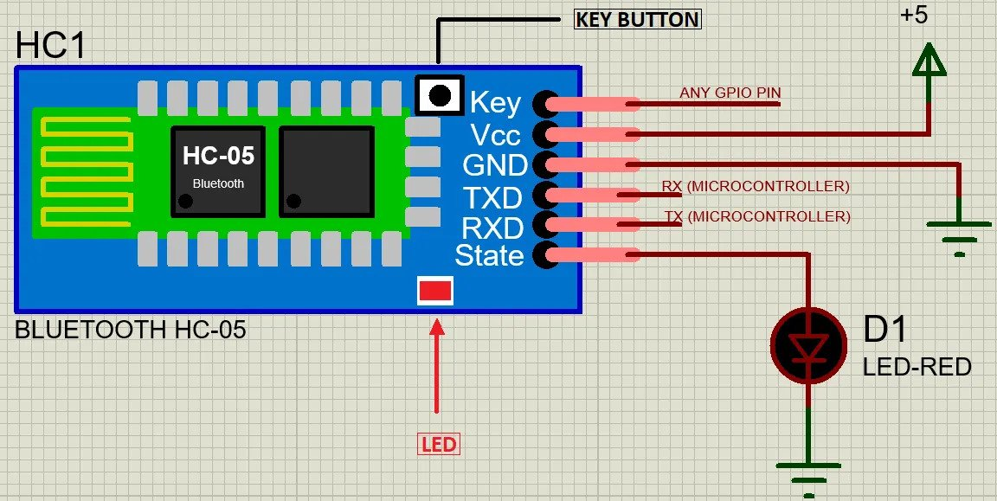
CONFIGURATION
PRINCIPLE OF OPERATIO
HOW TO USE
1. The TX will communicate with the controller's RX and the RX will communicate with the microcontroller's TX
D
65%
65%
55%
2. There is a third pin (Key) used to switch modes.
C
3. When no input signal is fed to the Key pin, the device will operate in data mode.
B
TYPE YOUR TEXT
TYPE YOUR TEXT
TYPE YOUR TEXT
A
4. After feeding a logical input signal to this pin, the device enters command line mode.
- Based on sequential communication protocol.
- Receive data and remove the beginning and end, then pass it through UART.
85%
25%
35%
1. Frequency: 2.4 GHz ISM band
7. Protocol: IEEE 802.15.1 standard
- Builds a Bluetooth packet and sends it over a Bluetooth wireless connection to the receiving device
2. Operating voltage: 3.3V to 5V
3. IC: BC417
TYPE YOUR TEXT
TYPE YOUR TEXT
TYPE YOUR TEXT
- HC-05 has two operating modes:
+ Command Mode:You can communicate with the Bluetooth module via AT commands
Ex: AT + NAME = ****** : To set/change device name
+ Data Mode: used to communicate with other Bluetooth devices
4. Flash memory: 8Mbit
5. Bluetooth version: 2.0 + EDR (Enhanced Data Rate)
6. Bluetooth system: Bluetooth CSR Bluecore 04 external single chip with CMOS technology

Slide 6
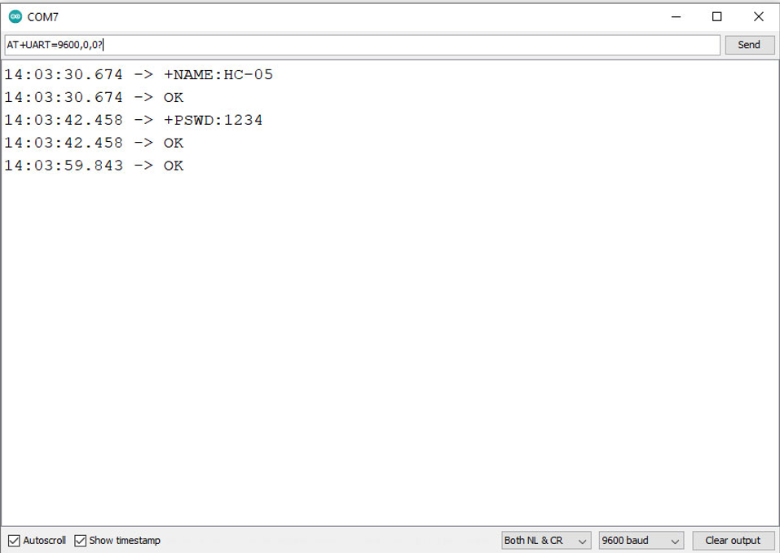
CONFIGURATION
PRINCIPLE OF OPERATIO
HOW TO USE
5. After entering command line mode, the module's default settings may change when using the following commands:
D
>> AT - To check the connection
65%
65%
55%
C
>> AT + NAME = ****** - To set/change the device name
>> AT + UART = *****, *, * - To set the transfer rate, stop bit and parity bit
B
TYPE YOUR TEXT
TYPE YOUR TEXT
TYPE YOUR TEXT
>>AT + VERSION? - Display version of Bluetooth module
A
>>AT + ORGL - The command to save settings has been executed
- Based on sequential communication protocol.
- Receive data and remove the beginning and end, then pass it through UART.
85%
25%
35%
1. Frequency: 2.4 GHz ISM band
7. Protocol: IEEE 802.15.1 standard
- Builds a Bluetooth packet and sends it over a Bluetooth wireless connection to the receiving device
2. Operating voltage: 3.3V to 5V
3. IC: BC417
TYPE YOUR TEXT
TYPE YOUR TEXT
TYPE YOUR TEXT
- HC-05 has two operating modes:
+ Command Mode:You can communicate with the Bluetooth module via AT commands
Ex: AT + NAME = ****** : To set/change device name
+ Data Mode: used to communicate with other Bluetooth devices
4. Flash memory: 8Mbit
5. Bluetooth version: 2.0 + EDR (Enhanced Data Rate)
6. Bluetooth system: Bluetooth CSR Bluecore 04 external single chip with CMOS technology

Slide 7
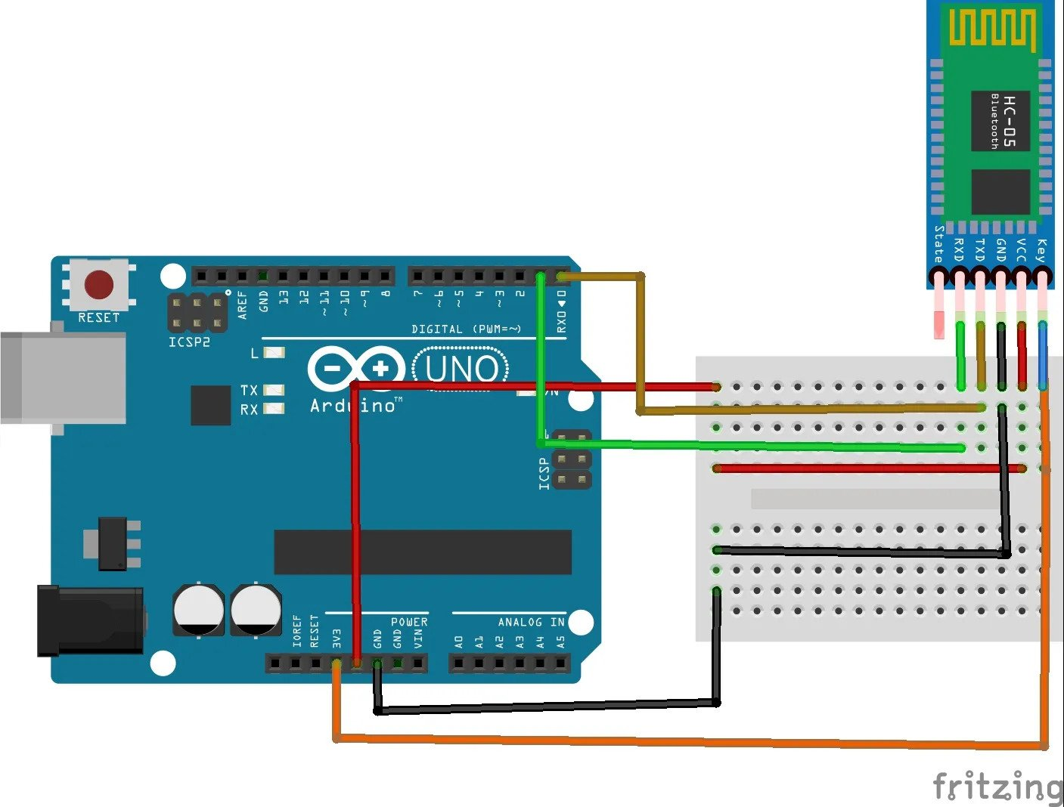
CONFIGURATION
PRINCIPLE OF OPERATIO
HOW TO USE
6. When the KEY pin is not plugged into the computer, it is connected to GND (Data mode)
D
65%
65%
55%
7. After plugging into the computer, we change the KEY pin via VCC 5V (or through the 3V3) (Command mode)
C
B
TYPE YOUR TEXT
TYPE YOUR TEXT
TYPE YOUR TEXT
A
- Based on sequential communication protocol.
- Receive data and remove the beginning and end, then pass it through UART.
85%
25%
35%
1. Frequency: 2.4 GHz ISM band
7. Protocol: IEEE 802.15.1 standard
- Builds a Bluetooth packet and sends it over a Bluetooth wireless connection to the receiving device
2. Operating voltage: 3.3V to 5V
3. IC: BC417
TYPE YOUR TEXT
TYPE YOUR TEXT
TYPE YOUR TEXT
- HC-05 has two operating modes:
+ Command Mode:You can communicate with the Bluetooth module via AT commands
Ex: AT + NAME = ****** : To set/change device name
+ Data Mode: used to communicate with other Bluetooth devices
4. Flash memory: 8Mbit
5. Bluetooth version: 2.0 + EDR (Enhanced Data Rate)
6. Bluetooth system: Bluetooth CSR Bluecore 04 external single chip with CMOS technology
8. Open the serial and switch Baud to 38400 then switch back to 9600 (baud rate adjustment)

Slide 8


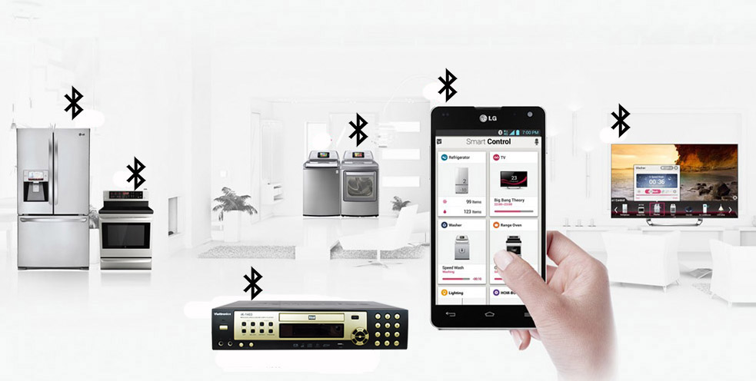
CONFIGURATION
PRINCIPLE OF OPERATIO
FUNCTION OF THE PINS
HOW TO USE
1. Embedded project.
6. When the KEY pin is not plugged into the computer, it is connected to GND (Data mode)
D
2. Data transfer between two HC-05 modules.
7. After plugging into the computer, we change the KEY pin via VCC 5V (or through the 3V3) (Command mode)
C
3. Send data from HC-05 to another Bluetooth device.
B
4. Control the device remotely via Bluetooth.
A
5. Control the robot via Bluetooth.
- Based on sequential communication protocol.
6. Wireless headphones and mouse.
- Receive data and remove the beginning and end, then pass it through UART.
1. Frequency: 2.4 GHz ISM band
7. Protocol: IEEE 802.15.1 standard
- Builds a Bluetooth packet and sends it over a Bluetooth wireless connection to the receiving device
2. Operating voltage: 3.3V to 5V
3. IC: BC417
- HC-05 has two operating modes:
+ Command Mode:You can communicate with the Bluetooth module via AT commands
Ex: AT + NAME = ****** : To set/change device name
+ Data Mode: used to communicate with other Bluetooth devices
4. Flash memory: 8Mbit
5. Bluetooth version: 2.0 + EDR (Enhanced Data Rate)
6. Bluetooth system: Bluetooth CSR Bluecore 04 external single chip with CMOS technology
8. Open the serial and switch Baud to 38400 then switch back to 9600 (baud rate adjustment)

